Slide 1
Face Recognition using FaceNet
- Amit Kumar

Slide 2
Contents
What is FaceNet
FaceNet Architecture
Triplet Loss
Triplet Selection
Harmonic Embedding
Harmonic Triplet Loss
Face Clustering
Code Demo

Slide 3
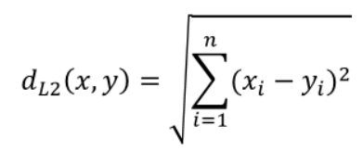
What is FaceNet
FaceNet is a Unified Embedding for Face Recognition and Clustering
Face recognition is a computer vision task for identifying and verifying a face based on a photograph
FaceNet is used to extract face features through face embeddings
FaceNet learns a mapping from face images to a compact Euclidean space
The Euclidean/squared L2 distances directly correspond to a measure of face similarity
The faces of the same person have small Euclidean distances and faces of distinct people have large distances
The feature embeddings/feature vector once extracted, can be used for face recognition, verification and clustering

Slide 4

FaceNet Architecture
The network consists of a batch input layer and a deep CNN followed by L2 normalization, that results in the face embedding followed by the triplet loss during training
Source Credit:https://arxiv.org/pdf/1503.03832.pdf

Slide 5

Triplet Loss
FaceNet is effective and unique due to the implementation of triplet loss as the loss function
Triplet loss is a loss function for artificial neural networks where a baseline input(anchor) is compared to a positive input and a negative input
Triplet Loss minimizes the distance between an anchor and a positive(face of the same person), and maximizes the distance between the anchor and a negative(face of a different person)
Source Credit:https://arxiv.org/pdf/1503.03832.pdf

Slide 6


Triplet Loss
Here is the input image/anchor of a person
is the image(s) of the same person (as the anchor image)
is the image(s) of a different person(compared to the anchor image)
is the margin enforced between positive and negative pairs
is the is the set of all possible triplets in the training set
Loss L =

Slide 7

Triplet Selection
Triplet Selection is done to ensure faster convergence
There are three categories of triplets:
easy triplets: triplets which have a loss of 0, because
hard triplets: triplets where the negative is closer to the anchor than the positive, i.e.
semi-hard triplets: triplets where the negative is not closer to the anchor than the positive, but which still have positive loss
Source Credit:https://omoindrot.github.io/triplet-loss

Slide 8
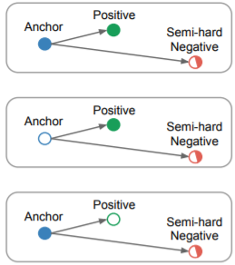
Harmonic Embedding
This denotes a set of embeddings that are generated by different models v1 and v2 but are compatible i.e, can be compared to each other
In order to learn a harmonic embedding, triplets are generated that mix the v1 embeddings with the v2 embeddings that are being trained. The semihard negatives are selected from the whole set of both v1 and v2
Source Credit:https://arxiv.org/pdf/1503.03832.pdf

Slide 9
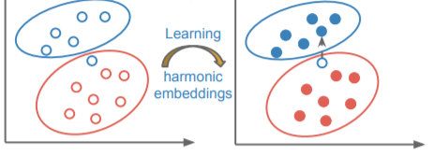
Harmonic Triplet Loss
In harmonic embedding, the embeddings of v1 are mixed together with the embeddings v2, that are being learned inside the triplet loss
This results in additionally generated triplets that encourage the compatibility between the different embedding versions
V2 embedding is initialized from an independently trained NN2 embedding and the last layer is retrained through random initialization with combability encouraging triplet loss
First the last layer is retrained, then the whole v2 network is trained with harmonic loss
Below figure shows a possible interpretation of how this compatibility works:
Source Credit:https://arxiv.org/pdf/1503.03832.pdf

Slide 10
Face Clustering
Once the compact embedding are generated, it can be used to cluster a users personal photos into groups of people with the same identity
Source Credit:https://arxiv.org/pdf/1503.03832.pdf

Slide 11
Code Demo
Steps:
Download FaceNet Model
Load a FaceNet Model in Keras
Detect Faces for Face Recognition
Develop a Face Classification System
- 5 Celebrity Faces Dataset
- Detect Faces
- Create Face Embeddings
- Perform Face Classification
Source Credit:https://machinelearningmastery.com/how-to-develop-a-face-recognition-system-using-facenet-in-keras-and-an-svm-classifier/

Slide 12
Thank You

